Slide 1
Energy and Industrial Plants
Consultancy & Project Management

Slide 2
About KLE Engineering:
KLE Engineering is a leading engineering and contracting company operating both in international and local markets including Mechanical, Electrical and Instrumentation Erection works from detailed engineering to procurement, fabrication and installation of project materials.
Managing Staff of KLE Engineering has taken role for the accomplishment of major Mechanical and electrical projects by using his dynamic team and international experience, latest information and technology in engineering & management sciences.
KLE managing staff always ensures the highest quality & standards based on international acknowledged procedures.

Slide 3
The main operation objective of KLE Engineering is to undertake and realize challenging projects including all disciplines such as;
Consultancy
Design
Project Management
Contract / Claim Management
Fabrication & Installation
Procurement Process
by targeting completion of the project scopes;
Main Targets:
On time – within budget – required quality – zero loss time injury rate

Slide 4
Main Fields of Activities :
Power Plants
Combined Cycle and Cogeneration Plants
Gas Turbines
Thermal Power Plants
Solar Power Plants
Wind Power Plants
Diesel Power Plants
Industrial Plants
Iron & Steel Plants
Cement Plants
Food, Beverage, and Medicine Plants
Steel Structure Fabrication & Erection
Structural Steel for Industrial Buildings
Platforms, Decks, Towers, etc.
Storage tanks, steels,
Secondary steel structure
Process Plants
Petroleum Refineries
Petrochemical Plants
Fertilizer Plants
Marine Works
Seawater intake/outfall systems
Jetty and platforms
Piling Works
Pump Stations
E&I / Power Distribution Facilities
Transformers & Substations
Switchyards
Cables, terminations
Instrumentation & Hook-up & Calibration
Grounding, Lighting & Lightning
Electrical Heat Tracing
Telecommunication Systems
Environment
Water Treatment Plants
Flue Gas Treatment Plants
Waste Water Treatment Plants
Pipe Spool Fabrication & Installation inc. NDT works
Carbon Steel Pipe Spools
Alloy Steel Pipe Spools
Stainless Steel
Duplex Pipes
GRP & HDPE Pipe Installation

Slide 5
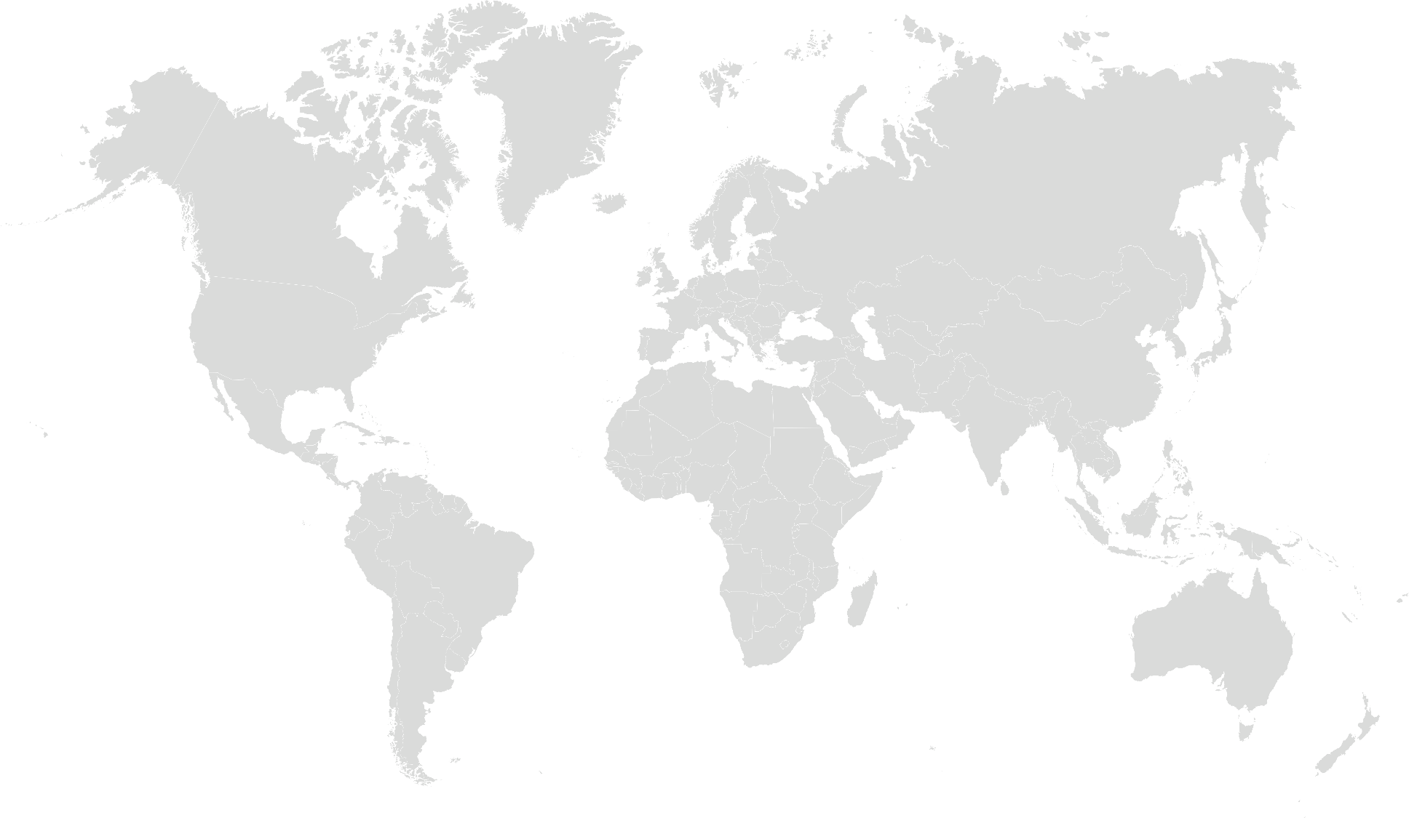
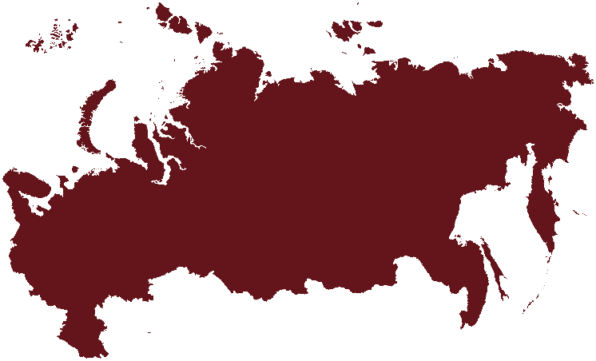
Main Projects completed by Managing Staff
Turkey
Russia
Albania
Turkmenistan
Azerbaijan

Slide 6
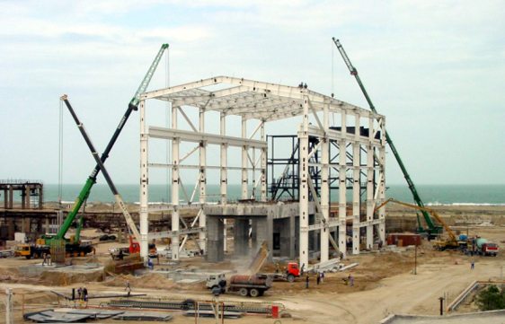
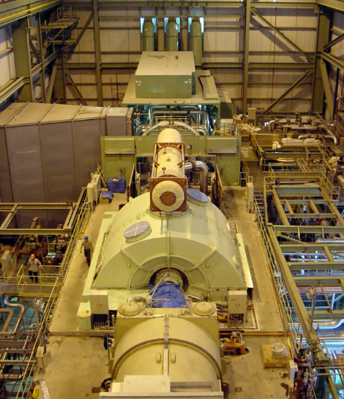
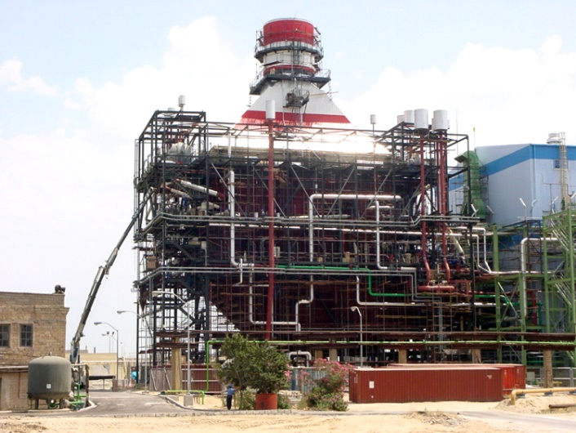
Severnaya 400 MW CCPP
Shuvelan, AZERBAIJAN
Owner: Joint Stock Company AZERENERJI
Consultant: Burns and Roe Enterprises, Inc.
EPC Main Contractor: Mitsui & Co. Ltd.
Sub-Contractors: Mitsubishi Heavy ınd. - ABB - EPRO
Date of Start / Completion: M/E/I Works August 1, 2001 / November 15, 2002
Description of work:
Complete Mechanical / Electrical / Control & Instrumentation Erection Works of 400.MW Single-Shaft
Combined Cycle Power Plant including Structural Steel works of GT Building / Pump House and Underground
CW Pipeline.

Slide 7
Major Equipment Erection:
Gas Turbine & Auxiliries: 710ton
Steam Turbine & Auxiliaries: 960ton
Main Transformer: 270ton
Gas Compressor: 110ton
Water Treatment Plant: 100ton
Start – Up Boiler: 175ton
Others: 800ton
Total: 3125ton
Piping:
Cooling Water Pipes: 2500ton
Power House&Off-Sites: 1200ton
Total: 3700ton
HRSG:
Steel Structure: 480ton
Modules: 1666ton
Drums & BDT: 136ton
Casing, Ducting & Stack: 211ton
Piping: 230ton
Insulation: 75ton
Others: 50ton
Total: 2848ton
Storage Tanks:
Total: 506ton
Electrical & Instrumentation:
Power & Lighting Cables: 118km
Control & Instrument. Cables: 213km
Switchgears, UPS, Batteries
Control System, Instruments
Steel Structure:
Turbine-Gen. Building: 1200ton
Others: 445ton
Total: 506ton

Slide 8
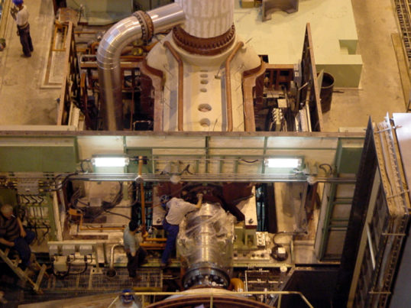
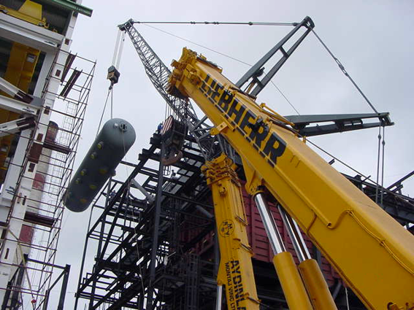
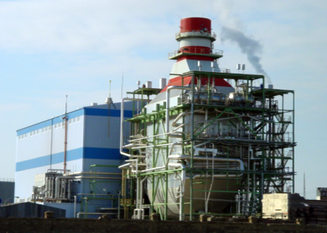
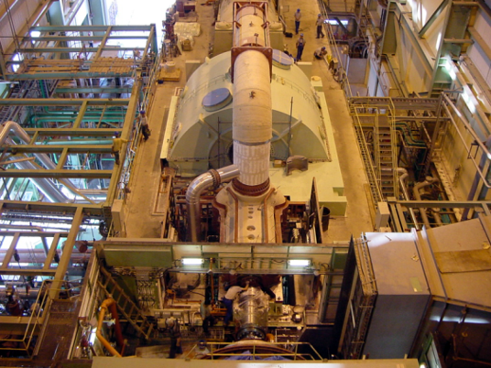

Slide 9
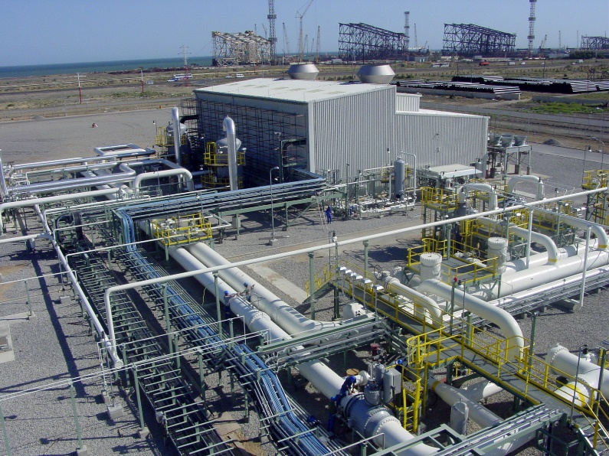
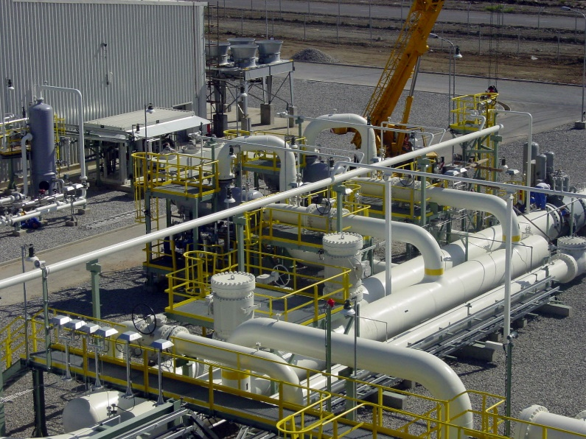
Karadagh GCSP
AZERBAIJAN
Owner: Joint Stock Company AZERGAZ
Main Contractor: Toyo Engineering Corp.
Civil and M/E/I Erection: TML – BOROVA - EPRO
Date of Completion: August 2003
Description of Work:
Complete Mechanical / Electrical / Control & Instrumentation Erection Works of Gas Compressor Station also including
Supply of all structural steelwork for compressor building and pipe racks
Design, supply and fabrication of fire works storage tank
Supply and fabrication of vent stack

Slide 10
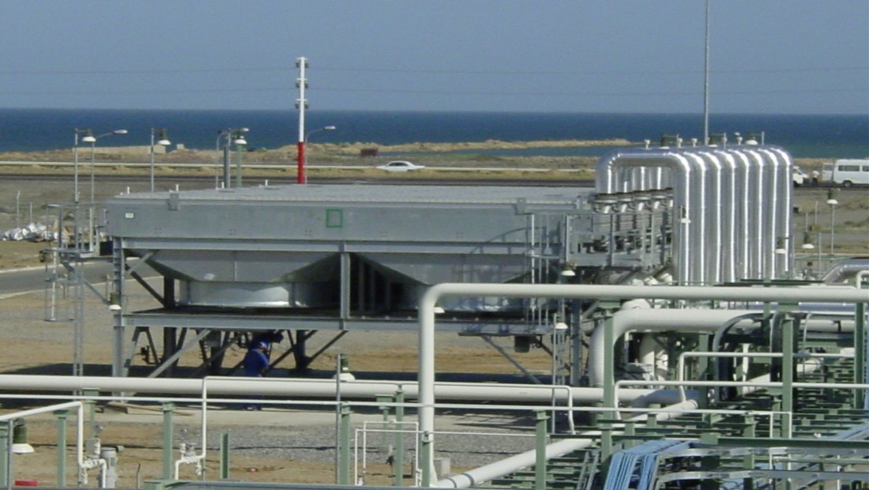
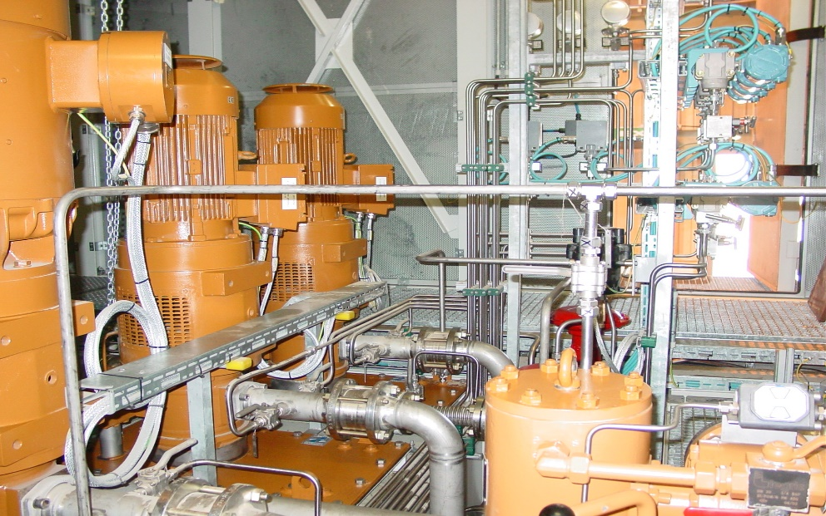
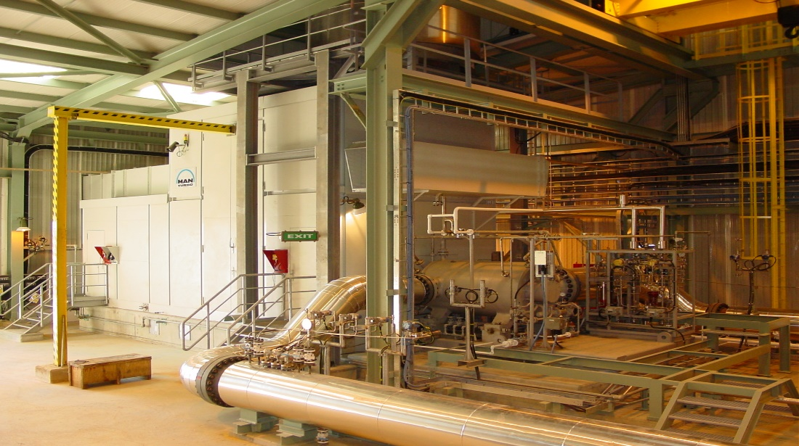

Slide 11
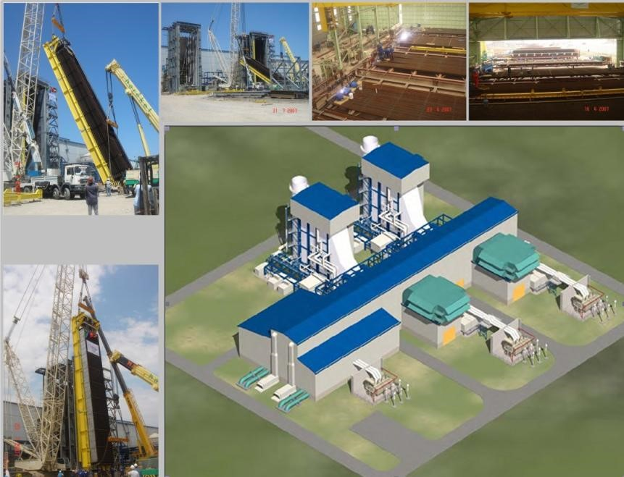
Sumgait 500 MW CCPP
AZERBAIJAN
Owner: AZERENERJI JSC.
Main Contractor: SIEMENS AG. Power Generation
Subcontractor: CMI Energy HRS – EPRO Power & Industrial Plants Inc. Consortium
Date of Contract: August 2005
Date of Completion: May 2007
Description of work:
Engineering, Supply, Manufacturing, Erection and Commissioning of 2 Heat Recovery Steam Generators

Slide 12
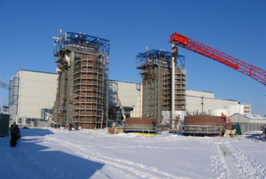
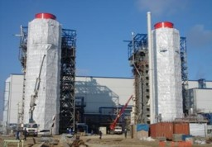
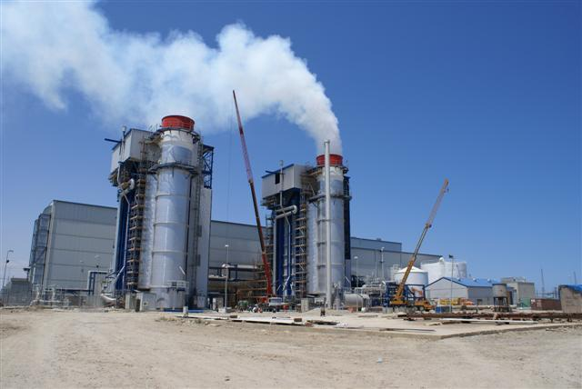
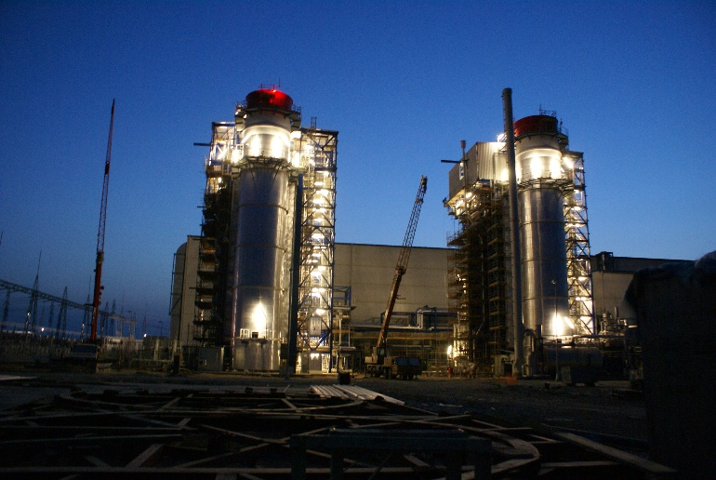

Slide 13
AKENERJİ CCPP
İzmir, TURKEY
Owner: Akenerji
Main Contractor: General Electric Energy Products Europe
HRSG Contractor: NEM BV, The Netherlands
Subcontractor: EPRO Power and Industrial Plants Inc.
Contract Date: 22 .01.2004
Date of Completion: December 2004
Description of work:
Complete Mechanical and Instrument Erection Works of 2 Heat Recovery Steam Generators and associated equipment
32 Tons piping including supports and valves
Instrument Installation
Supply and installation of Insulation
NDT, PWHT services

Slide 14
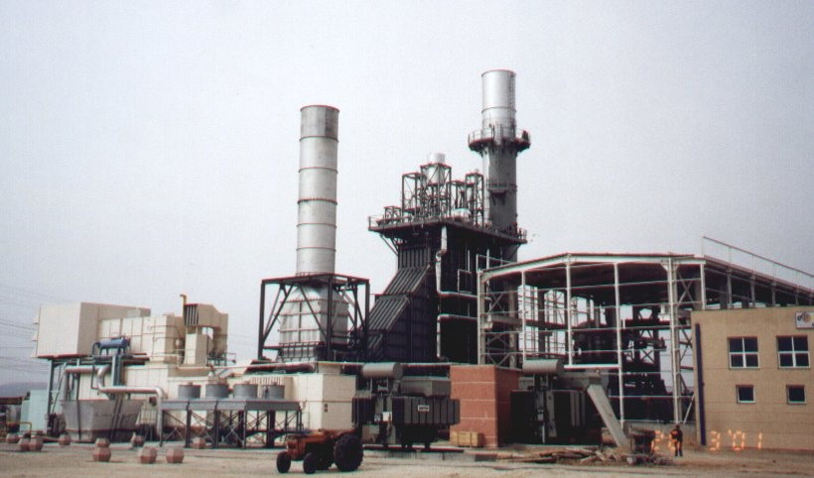
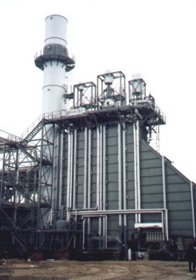
Eskişehir Industrial Power CCPP Eskişehir OSB ,TURKEY
Owner: Eskişehir Industrial Power Generation Autoproductor Group Co.
Supplier of Main Equipment: BABCOCK & WILCOX ESPANOLA S.A
Contractor: EPRO Power and Industrial Plants Inc.
Date of Completion: April 2001
Description of work:
Complete Mechanical and Instrumentation Erection Works of a Heat Recovery Steam generator and associated equipment.
523 tons Mechanical Equipment.
17 tons Piping including supports and valves.
Complete Instrument Installation works including supply of cables, cable trays,Conduits and junction boxes.
Complete Inspection and Test. (i.e. NDT, PWHT, HT, Blow-out)

Slide 15
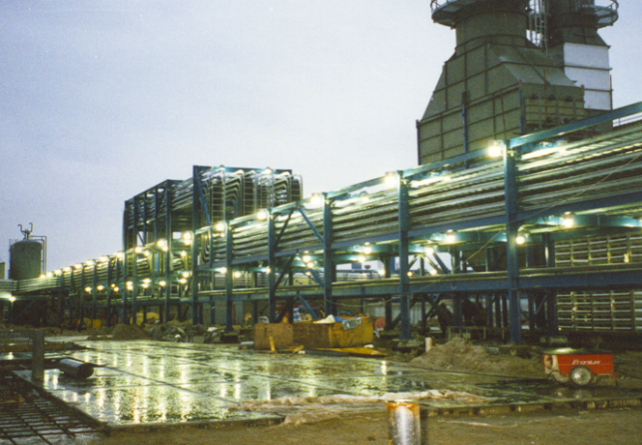
TOMSKNEFT GCS Leuginetskoye, Western Siberia, RUSSIAN
Owner: OAO TOMSKNEFT VNC
Main Contractor: Bateman International B.V, GAMA Industrial Plants Manufacturing & Erection Corp.
Subcontractor: EPRO Power and Industrial Plants Inc.
Date of Completion: November 1998
Description of work: Complete Electrical and Instrumentation Installation Works of Main Compressor Station and Booster Compressor Station including;
6 no. Power Transformers and Diesel Generators.
134 no. MV,LV Switchgears and MCC’s and HT panels.
1315 no. Lighting Fixtures including Poles, Supports and Accessories.
262 km. Power & Control and Instrument Cables including Terminations.
22 km. Heat Tracing Cables and complete HT Systems.
25 km. Cable Ladders, Trays and Conduits.
3120 no. Field Instruments including Calibration and Loop Checks.
8 km. Instrument Impulse Piping & 30 no. Instrument Panels (DCS & ESD Systems).
UPS, Power Metering and Monitoring Systems, Complete Lightning Protection & Grounding Systems.
Fire & Gas Detection Systems, Telephone & Communication Systems.

Slide 16
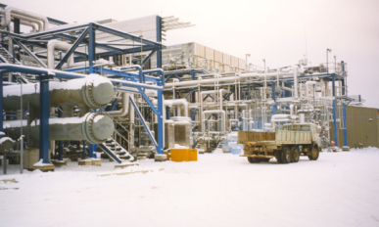
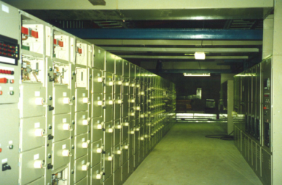

Slide 17
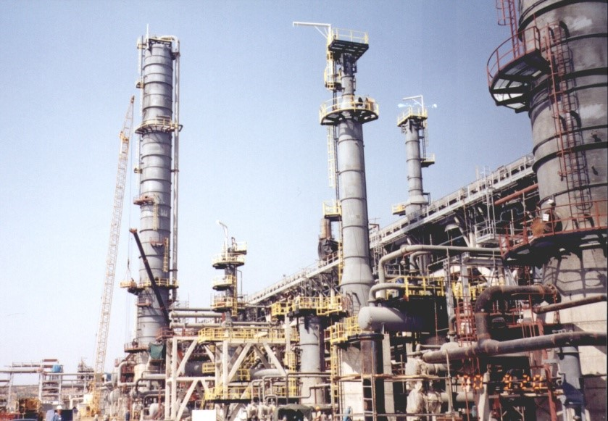
TÜPRAŞ CCR & ISOMERIZATION PLANT PROJECT
Aliağa, İZMİR, TURKEY
Owner: TÜPRAŞ,Turkish Petroleum Refineries Corp. İzmir Refinery
Consultant: Foster Wheeler Italiana
Main Contractor: GAMA Industrial Plants Manufacturing and Erection Corp.
Subcontractor: EPRO Power and Industrial Plants Inc.
Date of Completion: September 2000
Description of work:
CCR & Isomerization Plant project, Spool Fabrication &
Erection works of Underground and Aboveground Pipe Lines including;
645 tons On site Aboveground Piping Erection
285 tons Off site Aboveground Piping Erection
215 tons On site Underground Piping fabrication and Erection
100 tons Pipe Support Fabrication and Erection

Slide 18
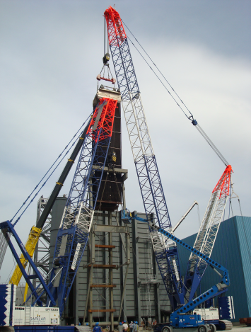
VLORE 1x100 MW CCPP
Vlore, ALBANIA
Owner : KESH Albanian Power Corporation
Main Contractor: MAIRE TECNIMONT S.p.A
Subcontractor: SOEPRO J.V. (EPRO Power and Industrial Plants Inc. – SOECO Engineering and Construction)
Date of Completion: September 2009
Description of work: Complete Mechanical Erection , Piping, Insulation and Painting Works of 100 MW Single-Shaft Combined
Cycle Power Plant.
Gas Turbine, Steam Turbine, Generator and auxiliaries (Supplied by Ansaldo-Italy)
HRSG (Supplied by Nooter Ericsen – Italy)
Condenser (Supplied by Ofmeco– Italy)
Piping and Supports (Fabrication, Erection, PWHT, NDT, Painting ,Insulation, Testing)
BOP Equipments and Systems i.e. Water Treatment Plant, Sea Water Pumps, Fuel Oil Storage, etc
4300 m. API 5L Fuel Oil Piping for Offshore connection between CBMS and Site (Welding and NDE testing)

Slide 19
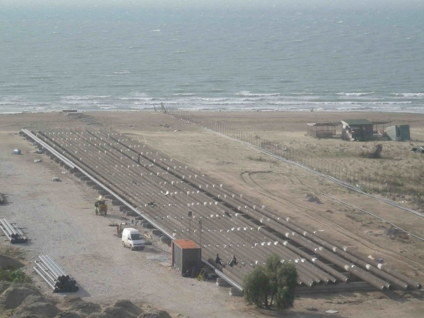
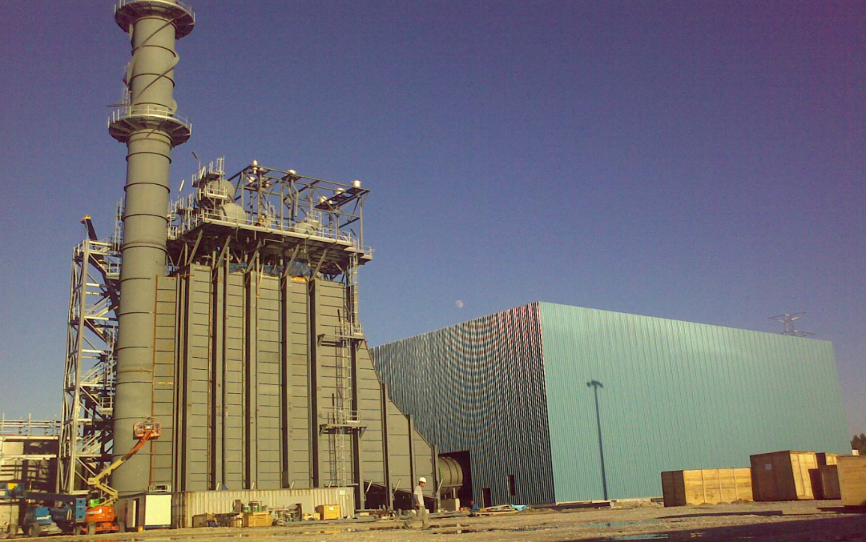
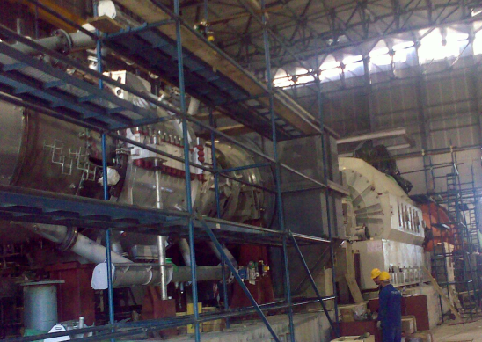

Slide 20
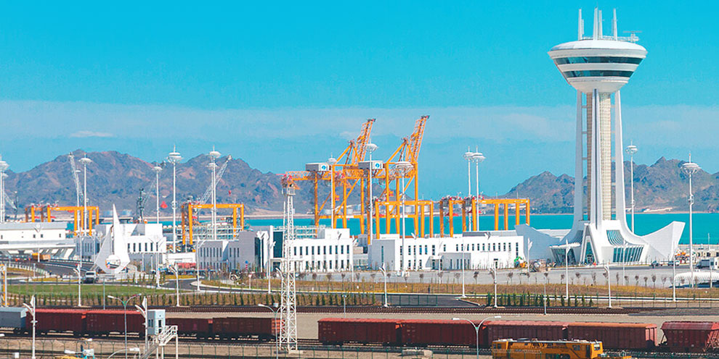
International Türkmenbaşı Seaport Project Turkmenbası, Turkmenistan
Owner : The State Service of Maritime & River Transportation of Turkmenistan
Main Contractor: Gap İnşaat
Designer: 2ER Consulting
Date of Completion: May 2 2018
Description of work:
The project “Türkmenbaşı Seaport” scope is not only importent for the EPC scope of below mentioned terminals
Ferry and passenger terminal,
Container terminal,
General cargo port
Bulk cargo port
Ship building and repair facility are built
Ro-Ro and polypropylene terminal is expanded.
But also, by the budget of $1.5 billion is constructed as the biggest seaport of the Caspian Sea

Slide 21
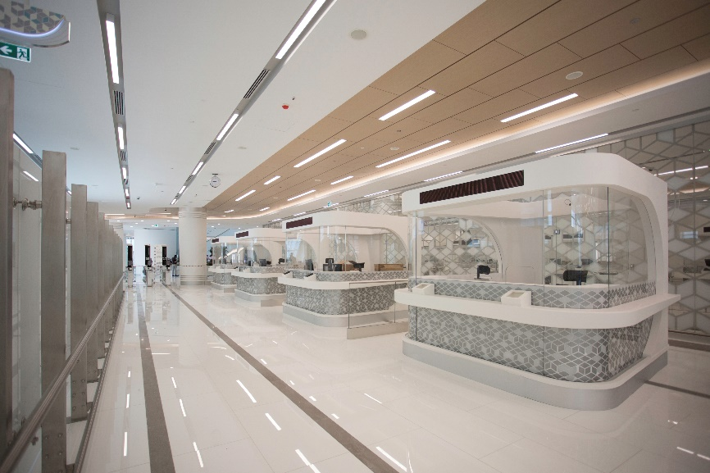
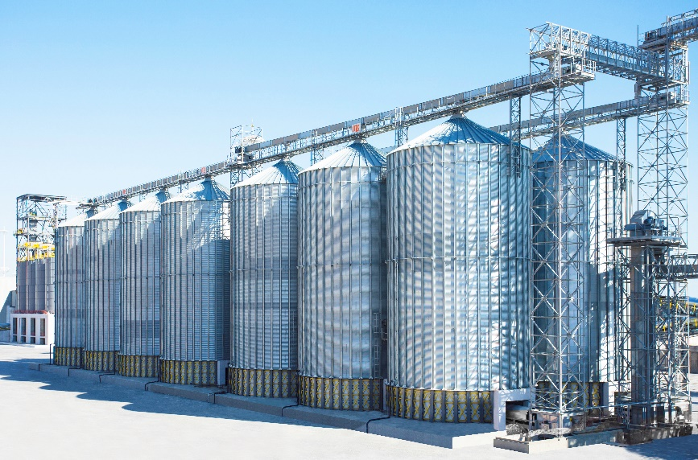
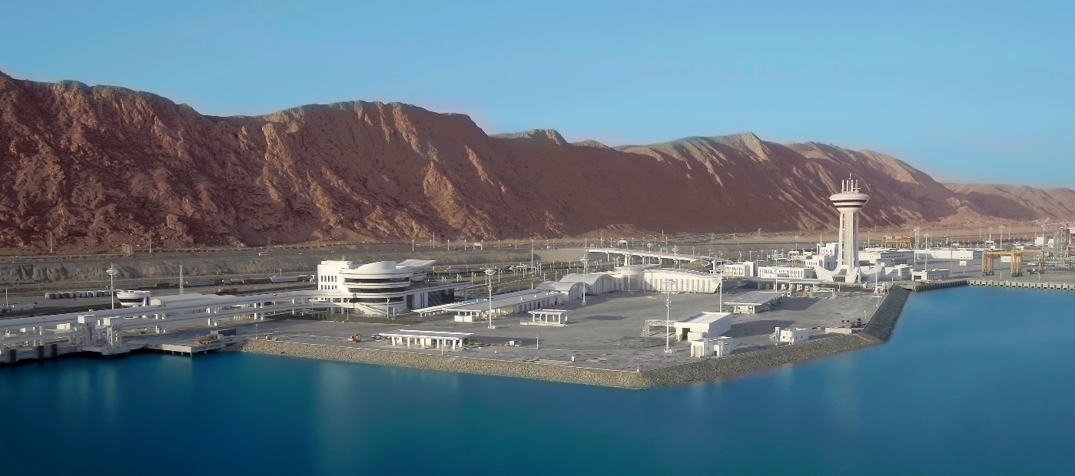
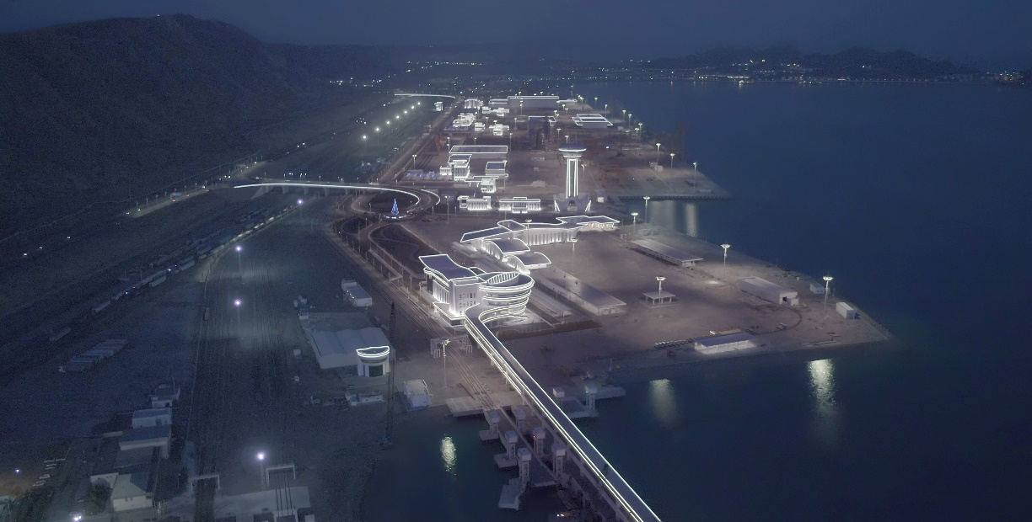

Slide 22
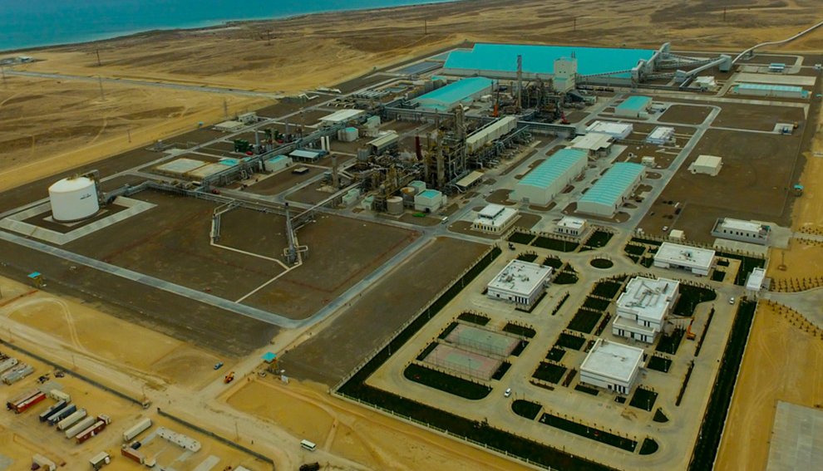
Garabogaz Ammonia and Urea Production Garabogaz, Turkmenistan
Owner : Turkmenistan Ministry of Chemistry
Main Contractor: Gap İnşaat / Mitsubishi Corporation
Subcontractor: Mitsubishi Heavy Industries
Date of Completion: June 30, 2018
Description of work:
Annual production capacity of 1.155.000 tons
Budget of $1.35 billion,
The biggest ammonia & urea production
plant of Turkmenistan

Slide 23
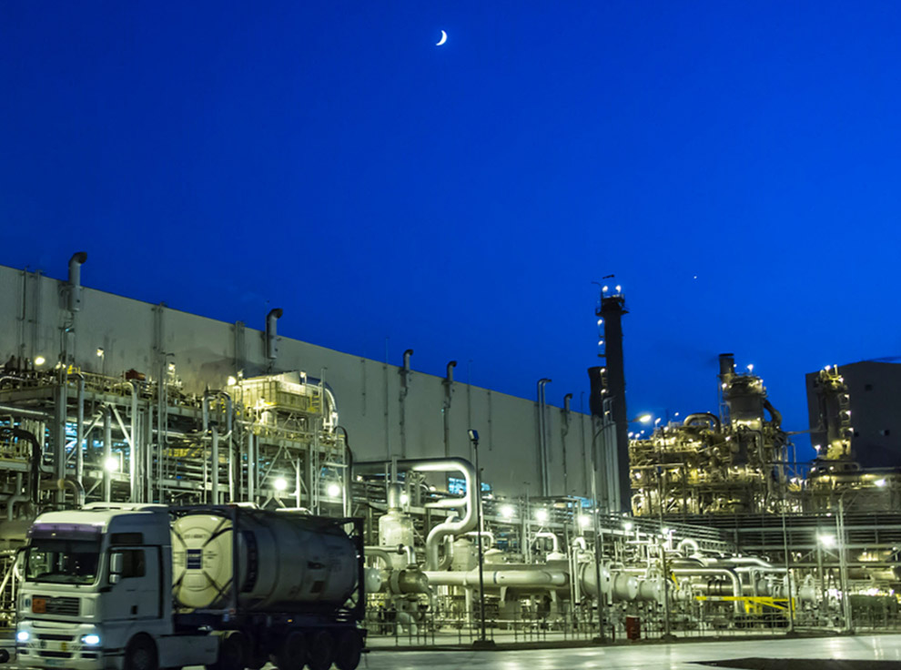
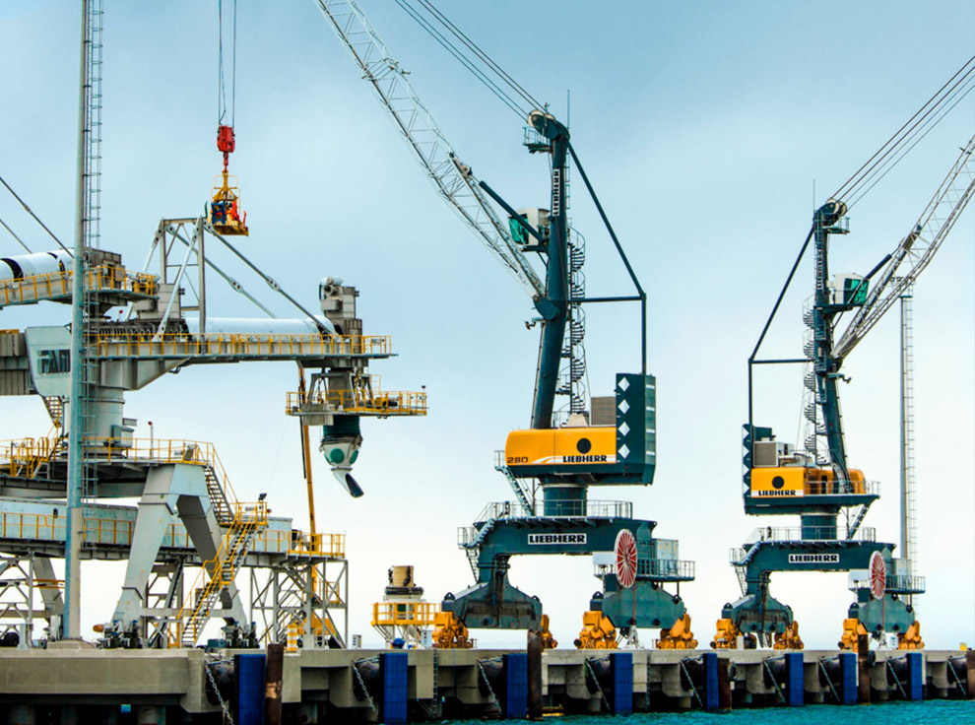
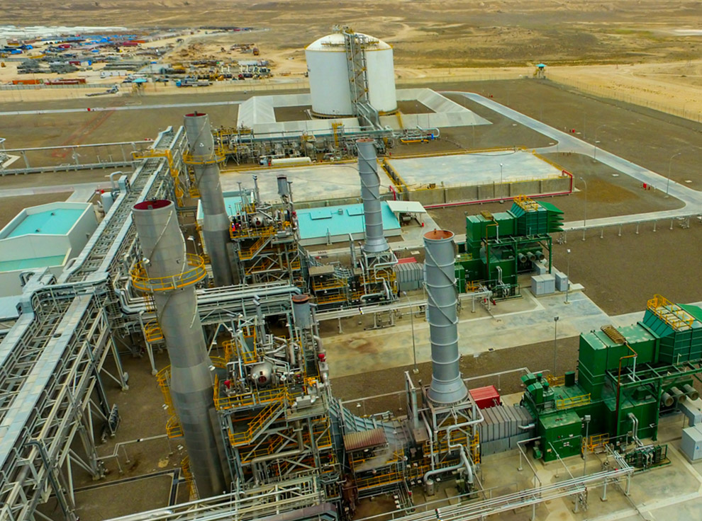
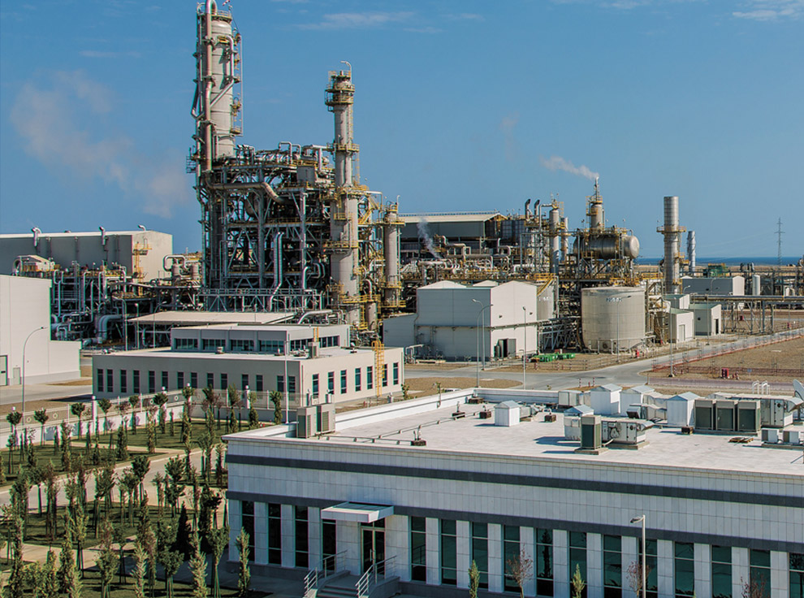

Slide 24
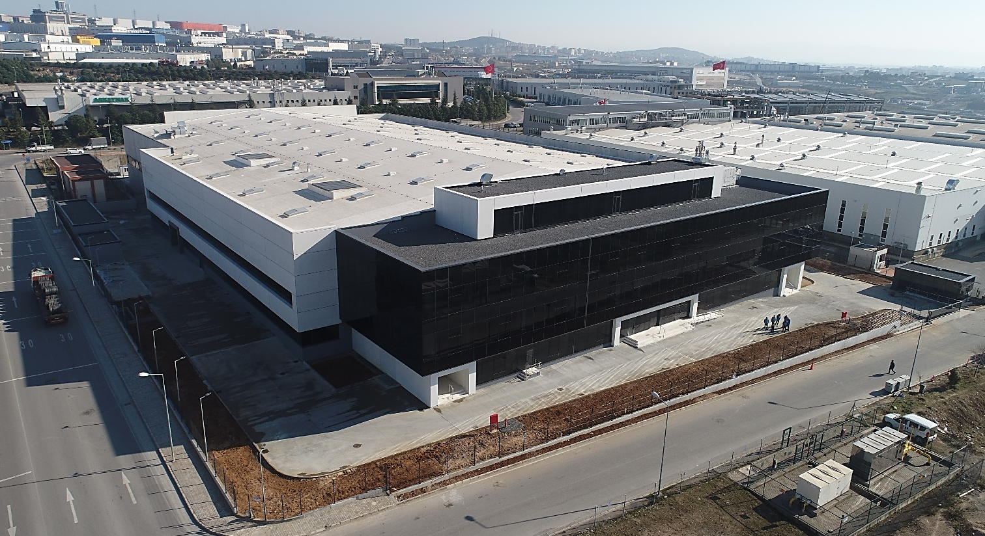
IMPRO – CENGIZ MAKINA
GEBZE, TURKEY
Owner : IMPRO Cengiz Makina
Main Contractor: Tekyol Plus
Designer: SEZA Eng.
Date of Completion: May 2 2018
Description of work:
Project managemet and consultancy including desing, procurement, installation, commissioning.
Contract management, claim management.
Total : 20.000 sqm

Slide 25
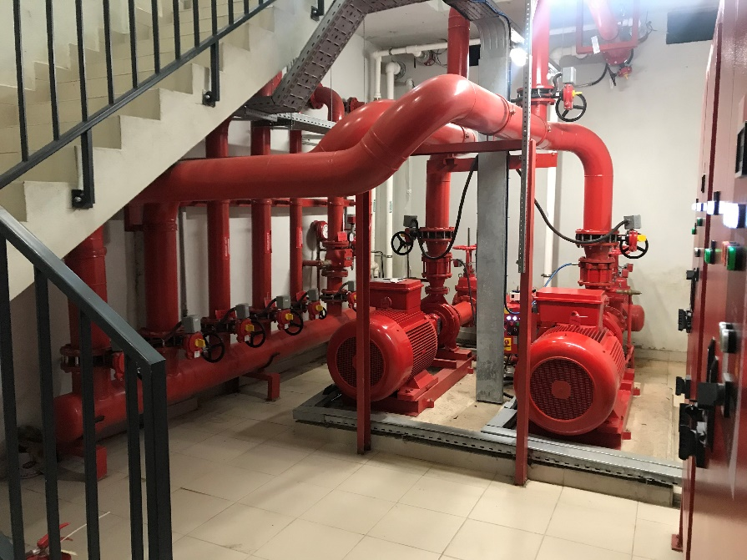
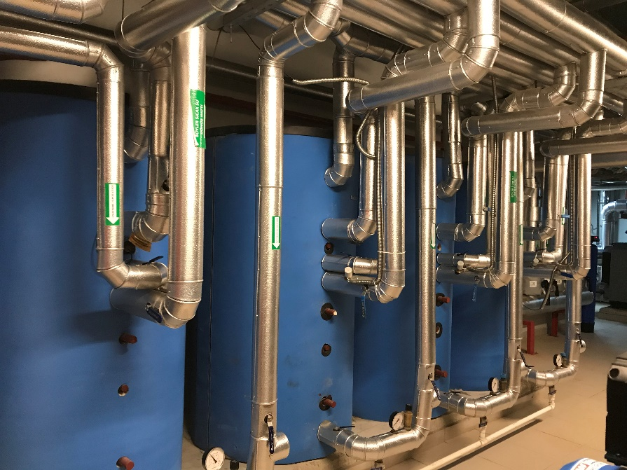
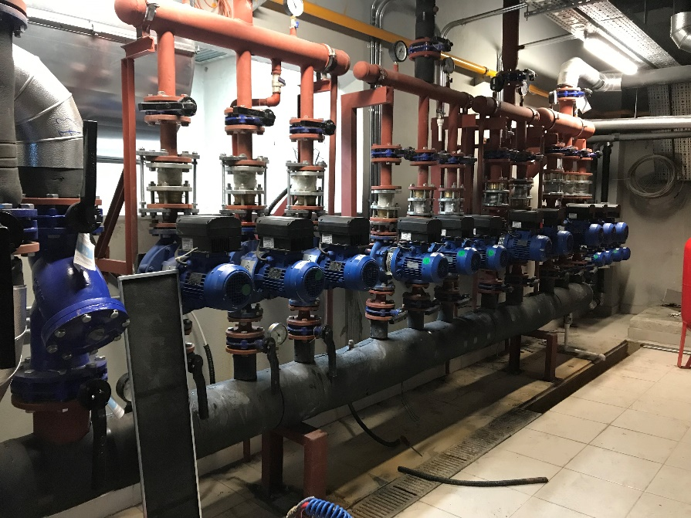
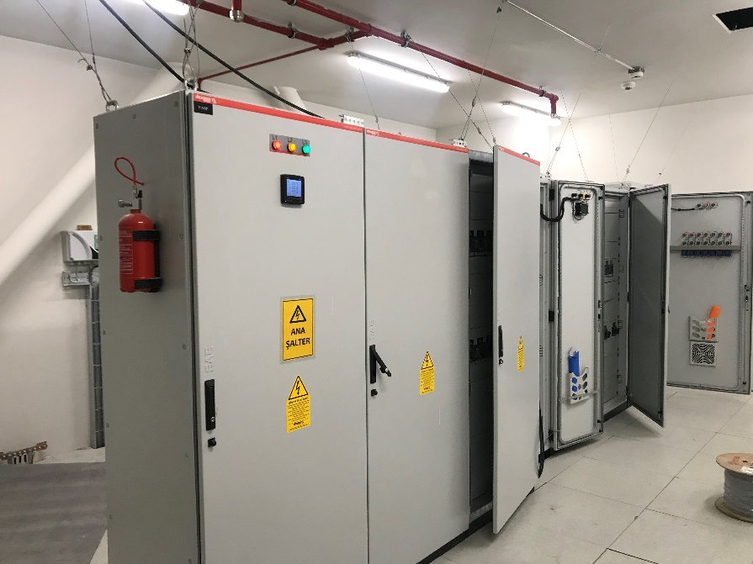

Slide 26
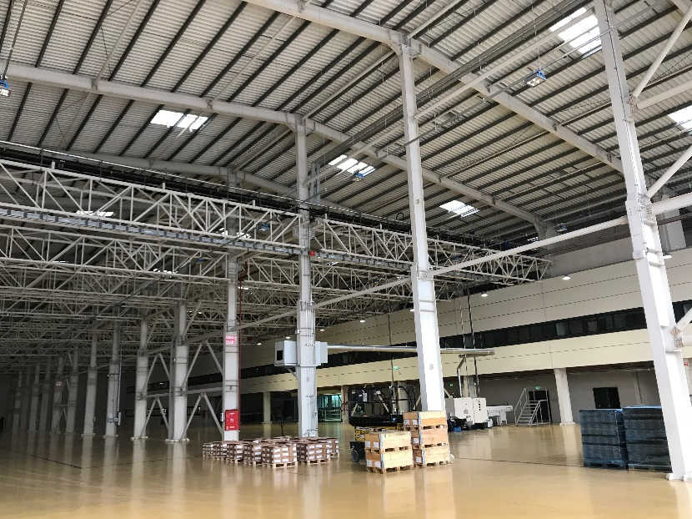
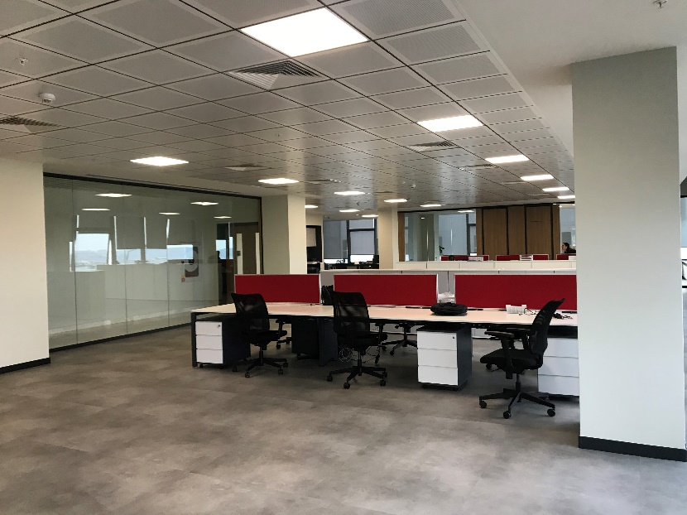
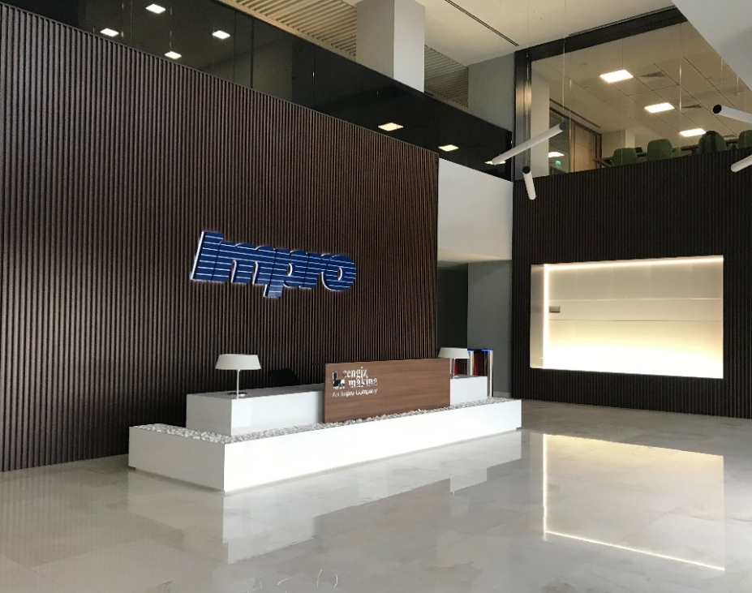
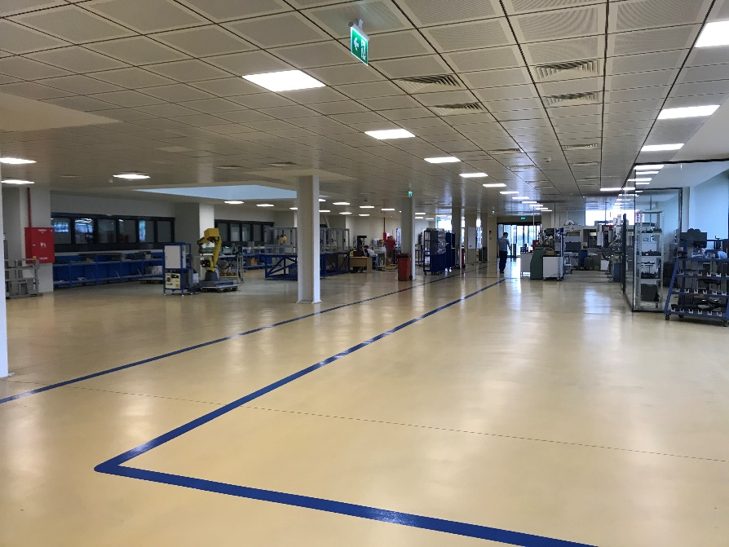
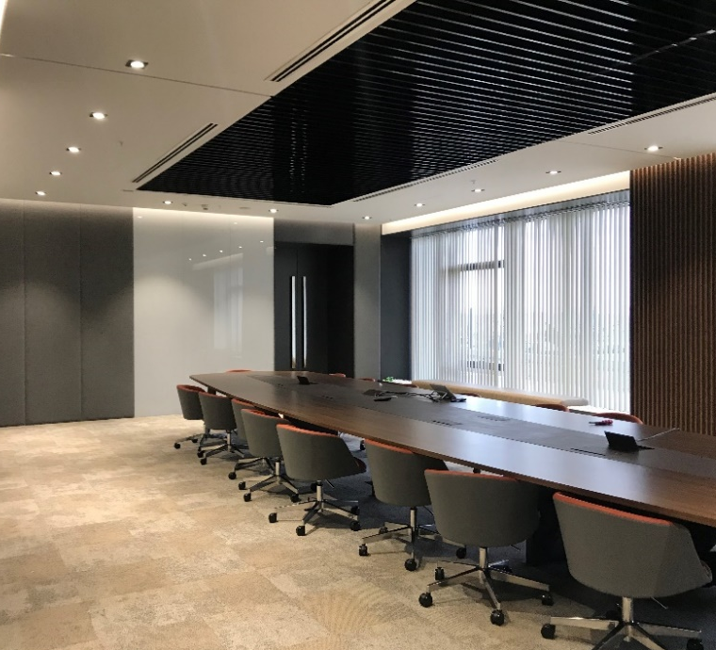

Slide 27
Thank You
www.kle-eng.com

